Slide 1

Connections – a pre-IETF India Forum
Dhruv Dhody
Secretary of IIESoc, Senior System Architect at Huawei Technologies
November 8-9, 2017
https://connections.iiesoc.in/
India Internet Engineering Society
https://iiesoc.in

Slide 2
Purpose
Discuss the interests and issues important to the network deployment, operation and design of networks in India as they impact IETF standards.
Educate and prepare new members for IETF involvement.
Facilitate member involvement in IETF areas.
Provide information, guidance and direction to assist Indian community in involvement in the IETF.

Slide 3
Format
Main Event
Hackathon
Hackathon encourage developers to collaborate and develop utilities, ideas, running code and solutions that show practical implementations of IETF standards.
Main event including technical invited talks on IOT, Security, SDN, Apps area
Experts with vast IETF and Industry experience
Various Panel discussion on each technical track with various technology background and perspectives
Technology area - IOT, TLS, DNS, SDN etc.
Participants are encouraged to demonstrate working open source projects

Slide 4
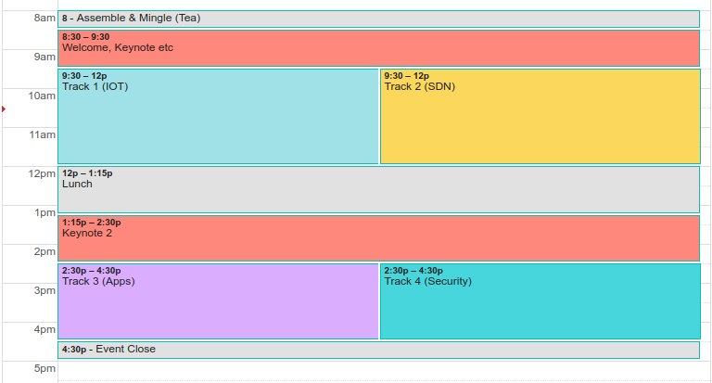
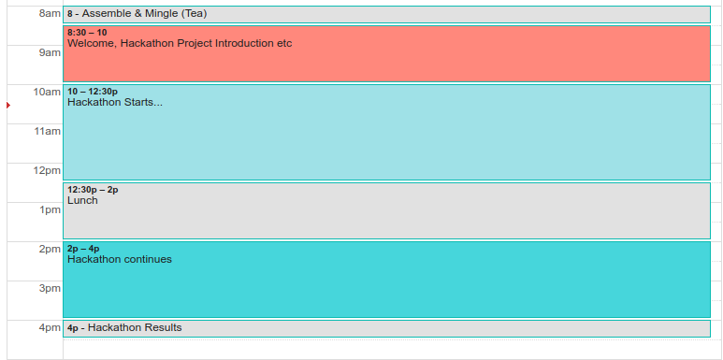
Format
Main Event (8th Nov)
Hackathon (9th Nov)

Slide 5
Technology Tracks
IOT
SDN
Security
Apps
The Internet of Things (IoT) refers to devices, that are often constrained in communication and computation capabilities, now becoming more commonly connected to the Internet, and various services that are built on top of the capabilities these devices jointly provide.
Security is key in today's Internet. The Security Area is the home for working groups focused on security protocols. They provide one or more of the security services: integrity, authentication, non-repudiation, confidentiality, and access control.
Software-Defined Networking (SDN) refers to a new approach for network programmability, that is, the capacity to initialize, control, change, and manage network behavior dynamically via open interfaces.
Protocols and Architectures to support applications.

Slide 6
Speakers
Fred Baker
Carsten Bormann
Paul Wouters
Mahesh Jethanandani
Vishnu Pavan Beeram
NetConf WG chair
OPSDIR, Yang Doctors
Cisco
TEAS WG chair
Juniper
CORE WG chair, T2T RG chair
IOTDIR
TZI
TRANS WG chair
SECDIR
Redhat
Past IETF chair
V6OPS chair
OPSDIR
Many more speakers from India from Vendors, Academia, Opensource space….

Slide 7
Hackathon
Hackathons encourage developers to collaborate and develop utilities, ideas, running code and solutions that show practical implementations of IETF standards. Hackathon will be held on 9th November.
This is also an excellent mechanism to participate in IETF by bringing in the implementation experience and providing useful comments to, in-progress standards.
Goals -
Advance pace and relevance of IETF standard activities from India by bringing in the Indian ICT & developers to collaborate on implementing above cited technologies.
Provide Hackathon as an entry point for developers and engineers to join IETF activities by initially providing implementation experience, later collaborating on standards, take part in IETF Hackathon activities.
Educate new developers and expose them to new standards in IETF
Bring interoperability concerns and newer features (possibly from an Indian and/or Industry/ISP context
Suggested Project/ Technologies Areas
IOT, Security/TLS, SDN, DNS, QUIC/HTTP 2.0

Slide 8
Help OUT!
Mark your calendars and make sure to attend the event, and use this opportunity!
Please publicize the event in your organization and groups
Please volunteer for the event and help us, in making it a success.
If your organization would be interested in sponsorship, please link us up.
Details at - https://www.connections.iiesoc.in/sponsorship

Slide 9


